Slide 1
Analysis of Cycling Traffic in Paris
Team members:
Amal Mohamed
Chelsea Wright
Dirk Eisermann
Notes:
Amal
Hi everyone, before we dive in, I would like to introduce my colleagues Chelsea, Dirk, and myself, Amal. We will be presenting our project on analyzing cycling traffic in Paris.

Slide 2
Outline
Introduction
Data Exploration
Data Visualization
Data Cleaning and preprocessing
Modeling (Power BI Demo)
Conclusion
Notes:
Amal
Here is the outline of our presentation: we will take you through the journey of our project, highlighting key aspects and findings.

Slide 3
Introduction
Paris’ vision for cycling:
Become one of the most bike-friendly cities in Europe.
Significant investments to enhance cycling infrastructure.
Data source and description:
opendata.paris.fr
Contains hourly count of cyclists registered by the different bicycle counters across Paris.
Notes:
Amal
In 2021, Paris launched the ambitious Plan Vélo: Act 2, aiming to transform the city into one of the most bike-friendly cities in Europe. To achieve this, the city has invested significantly in the infrastructure to encourage cycling among residents and tourists.
To analyze the impact of these efforts, we used data from opendata.paris.fr. This dataset contains the hourly cyclist counts recorded by different bicycle counters installed across Paris.

Slide 4
Objectives
The scope of our analysis:
Identify cycling traffic trends and patterns in Paris.
Review the impact of events on bicycle usage:
Cycling-friendly initiatives taken for the 2024 Summer Olympic and Paralympic games
Unsupervised machine learning models:
Identify the distribution of cycling traffic patterns throughout Paris.
Supervised machine learning model:
Predict afternoon cyclist counts from morning cyclist counts.
Notes:
Amal
By analysing this dataset we aim to:
Identify the trends and patterns of cycling traffic in Paris.
Review the impact of Olympics and Paralympics games on bicycle usage.
Then Identify the distribution of cycling traffic patterns using unsupervised ML
And lastly predict afternoon cyclist counts from morning cyclist counts using supervised ML

Slide 5
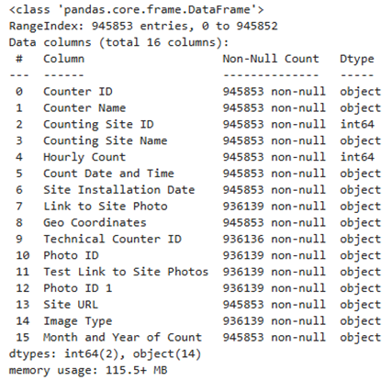
Data Exploration
Language used: Python
Libraries used: Pandas, NumPy, Matplotlib, Seaborn, Scikit-learn
Size: 945,853 rows x 16 columns
Period: 2022-2024
Numeric variable: ‘Hourly Count’
Categorical variables: e.g., ‘Counting Site Name’, ‘Count Date and Time’ and ‘Geo Coordinates’
Notes:
Amal
To explore our dataset, we used Python lan., and libraries like Pandas, NumPy, Matplotlib, Seaborn, and Scikit-learn.
The dataset consists of 945,853 rows and 16 columns as shown in the figure, covering the period from 2022 to 2024. It includes one numeric variable 'hourly count', while the other variables are categorical.

Slide 6
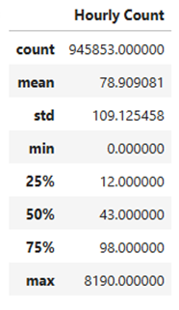
Descriptive Statistics
Findings :
High variability:
Low mean (~79) and high standard deviation (~109)
Fluctuations in hourly cyclist counts:
First quartile (Q1 = 12) and Third quartile (Q3 = 98)
Potential outliers:
Wide range between the minimum (0) and maximum (8190)
Notes:
Amal
Continuing with the exploration, we also looked at the descriptive statistics of our numerical variable to understand the variability in our data.
We found that our data shows high variability, with a low mean (~79) and a high standard deviation (~109).
As well as the gap between the first quartile (Q1 = 12) and third quartile (Q3 = 98), indicates significant fluctuations in hourly cyclist counts.
Additionally, the wide range between the minimum (0) and maximum (8190) suggests outliers.
Therefore, these findings require further investigation, which will be discussed in the next section.

Slide 7
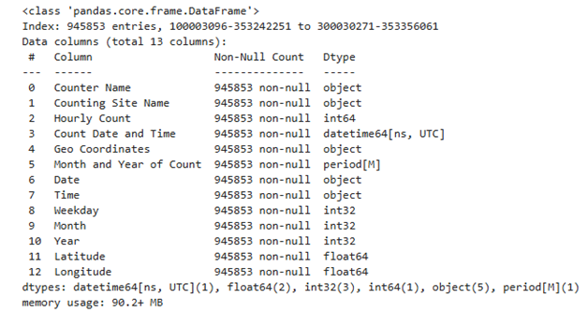
Data Processing
Duplicates: No duplicates
Missing values: Irrelevant missing values
Data conversion: ‘Count Date and Time’ and ‘Month and Year of Count’ columns to datetime format
Extract new variables: Temporal and Geographical
Notes:
Amal
Before moving to our initial analysis, we had to prepare our data:
Since there were no duplicates or missing values, we only converted the temporal columns to datetime format and extracted new variables to easily manipulate our data. As shown in the summary information on the right, representing our dataset, we can see the new variables such as date, weekday, longitude, and latitude.
Now, I'll hand it over to Chelsea, who will walk you through the data visualization section.

Slide 8
Data Visualization
Outlier Detection
Missing Readings
Zero Counts
Cycling Traffic Volume
Geographic Distribution of Counters
Excurse: Olympic and Paralympic Periods
Notes:
Chelsea
Now I’ll present our most important findings from the data visualization portion of our project.

Slide 9
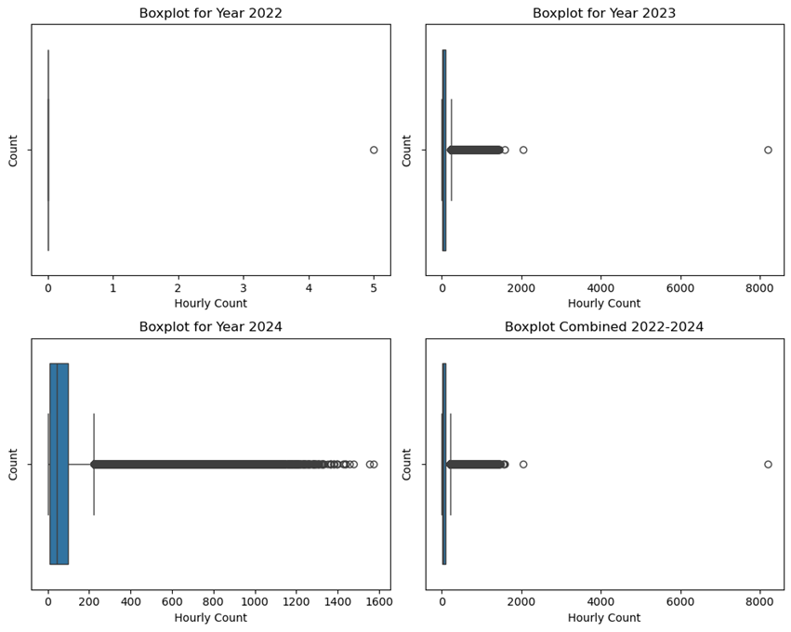
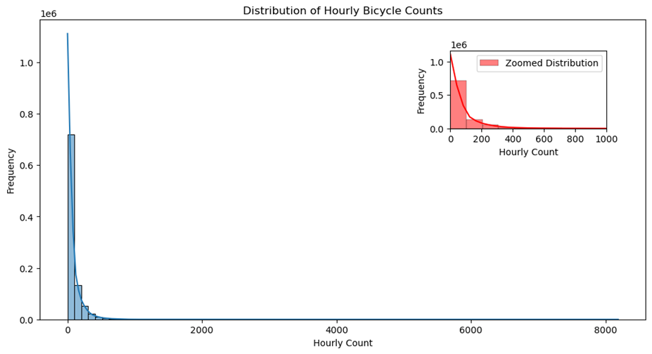
Outlier Detection
Notes:
Chelsea
We began by looking at the target variable in our dataset - the hourly counts. On the right you can see in the histogram that there is a heavy right skew - meaning most of the hourly counts taken by the counters were between 0 and 100, and got increasingly smaller from 101 on.
From the boxplots by year, we can see that there are two extreme outliers with an hourly count of over 2000. We ended up excluding those hourly counts for the subsequent modeling.

Slide 10
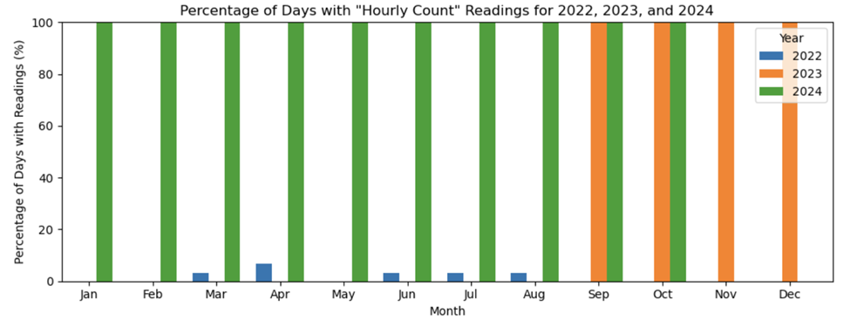
Identification of Missing Readings
Notes:
Chelsea
To check the completeness of our data over time, we next visualized what percentage of each month had hourly count readings. As you can see 2022 was very incomplete, with just a few days in a few months having readings, and then 2023 only had readings for the last 4 months of the year. 2024 had complete data up until when this analysis was done (Mid October).
So we decided to exclude 2022 and the first 9 months of 2023 from our modeling dataset.

Slide 11
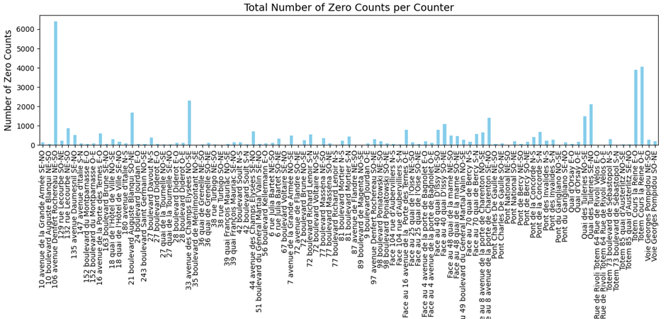
Zero Counts
Notes:
Chelsea
We also checked for another form of missing readings, which was counters that recorded an hourly count of zero. We found that there were 41582 instances (4.5% of the total data) of this. As you can see in the graph, the distribution of these occurrences is not consistent across all the counters. This inconsistency suggests that these zero counts are not merely due to periodic malfunction of counters, so there therefore must be other contributing factors. However, since an hourly count of 0 is realistically possible, and we couldn’t know for sure which cases were true and which were errors, we decided to keep all hourly counts of 0 in our dataset for modeling.

Slide 12
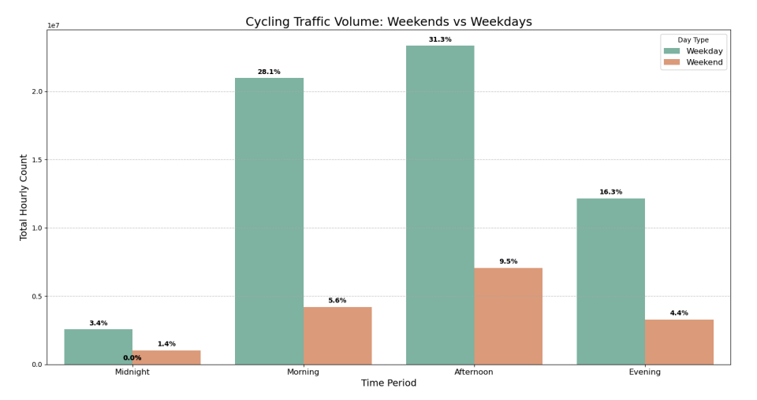
Volumes of Cycling Traffic
Notes:
Chelsea
We then sought to get an idea of how the cycling traffic differs during different periods of the day, and for weekdays vs weekends. As you can see in the graph, the cycling traffic is heavier during weekdays (green), for all periods, with most traffic happening in the mornings and afternoons, so between 6 am and 5 pm.
From this strong difference between weekdays and weekends, we can conclude that it is probably people commuting to work and school who are the primary cyclists in Paris, and not tourists.

Slide 13
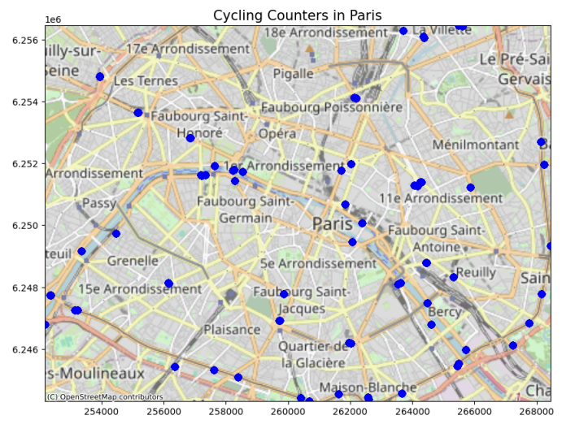
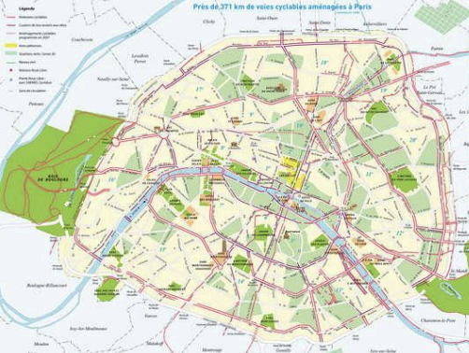
Geographic Distribution of Counters
Notes:
Chelsea
To get an overview of the geographic locations of the counters, we plotted them on a map of Paris. Comparing the locations of the counters (left), and a map of the cycling paths/lanes in Paris, we can see that they are mostly located on those routes, which is logical.

Slide 14
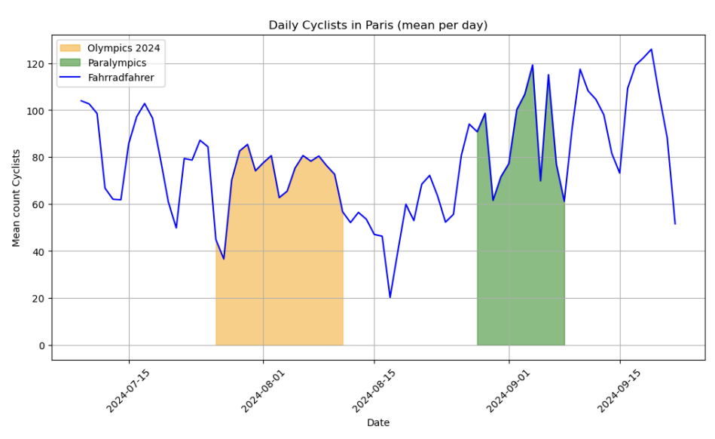
Excurse: Olympics and Paralympic periods
Notes:
Chelsea
Our data encompassed the period where the Olympic and Paralympic games were held in Paris, so I’ll now briefly present our findings on that. The city made significant investments in improving their cycling infrastructure in preparation for the games, with the goal of encouraging visitors to travel by bike to ease car traffic and overcrowding on public transportation. So we sought to investigate how well their plan worked.
We can see here that volume of cycling traffic decreases from July to mid-August, and then increases again after that. The Olympic and Paralympic date ranges are highlighted in yellow and green, respectively. Whether this trend of a decrease followed by an increase was due to the Olympics or other factors (eg, that it was summer holidays) is unknown. And since our dataset didnt include counts from the same period in the previous years, we couldnt draw a comparison.

Slide 15
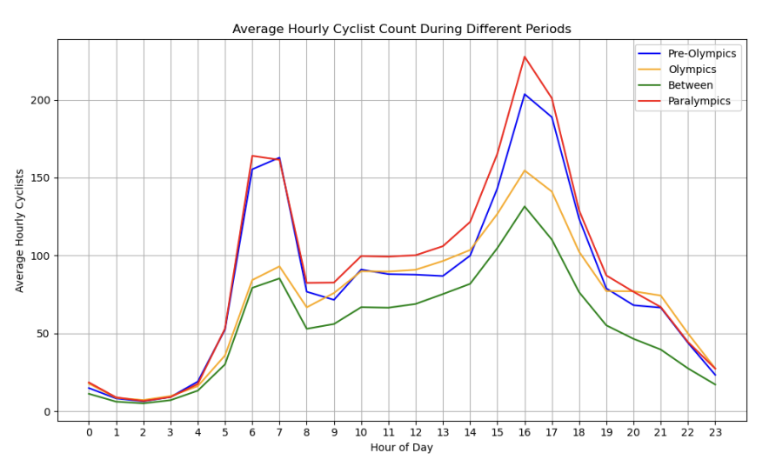
Excurse: Olympics and Paralympic periods
Notes:
Chelsea
In this graph we can see how the cycling traffic volume varied at different hours of the day during the different periods -so before, during the Olympics, between games, and during the Paralympics. The most important takeaway here is that the daily traffic trend is the same for the periods during and not during the games, and as we saw earlier the traffic volume follows the typical commuting times. So it was mostly still commuters cycling, and not tourists.
So from this we can conclude that Paris’ initiative to get tourists cycling during the Olympics and Paralympics didn’t really work. However, Parisians will benefit from the improvements in cycling infrastructure that were made.
Overall, due to the abnormal circumstance in Paris during these times, like road closures and Parisians being encouraged to avoid certain areas and take alternate routes, we decided to exclude the this period from our modeling dataset.

Slide 16
Data Cleaning and Preprocessing
Outliers: Remove two extreme outliers (2047 and 8190 counts per hour)
Missing Data: Exclude 2022, first 8 months of 2023, and Oct 2024 (only halfway through month at time of analysis)
Zero Counts: Retain zero counts
Olympic Period: Exclude July-September 2024
Dataset for Modeling
Time Period: September 2023 - June 2024
Variables: ‘Hourly Count’, ‘Counter Site Name’, ‘Time’, ‘Weekday’, ‘Month’, ‘Year’, ‘Latitude’, and ‘Longitude’
Notes:
Chelsea
After the visualization we cleaned and preprocessed our data for modeling. At the top is a summary of what we did to clean our dataset, which I just explained in the previous slides. So our final dataset for modeling encompassed the period from Sept 2023 to June 2024, and the relevant variables we kept in the dataset and extracted from other columns are listed here in number 6.

Slide 17
Modeling
Objective:
Identify traffic patterns and predict afternoon cycling traffic based on morning counts.
Methods:
Clustering analysis (K-mean and hierarchical DBSCAN)
Linear regression analysis
Notes:
Dirk
For the modeling part, we tried to find out whether there are areas where cycle traffic is significantly different compared to other parts of the city. We expected to find counters with similar traffic patterns and usage throughout the day. To explore this, we used two different types of clustering models.
In the second step, we used this information to develop a prediction model.

Slide 18
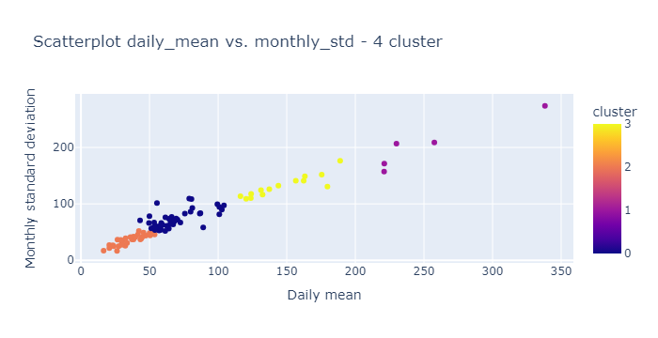
Clustering KMean
Features for Clustering:
Average daily cyclist counts.
Average weekly sum of counts.
Average monthly standard deviation
of counts.
K-Means Clustering:
Best Model: 4 clusters with 3 features.
Evaluation Metrics:
Euclidean Average: 2.77
Manhattan Average: 4.79
Silhouette Score: 0.493
Notes:
Dirk
At first we tried the KMEan-model. We varied both the number of clusters and the number of features. The model with the following features proved to be the best for clustering: 'Average daily cyclist counts', 'Average weekly sum counts', 'Average monthly standard deviation of counts'. This model delivers good results with relatively little effort.
The metrics show a satisfactory result. The clustering makes sense, but there is room for improvement. In particular, the high number of low counts is a problem for modelling. Further analyses would be useful at this point.
(The evaluation metrics suggest that the K-means clustering model is usable but may benefit from further refinement. The Euclidean and Manhattan averages indicate a moderate cluster compactness, while the Silhouette Score of 0.493 suggests an acceptable but not optimal cluster separation. Potential improvements could involve testing alternative numbers of clusters, refining features, or exploring alternative clustering algorithms to achieve better-defined clusters. Specifically, the distinction between the two smaller groups might be responsible for the poor values. These two clusters overlap, and the count values are very close to each other. This inaccuracy is accepted at this point. Further analyses will demonstrate that this decision is justifiable.)

Slide 19
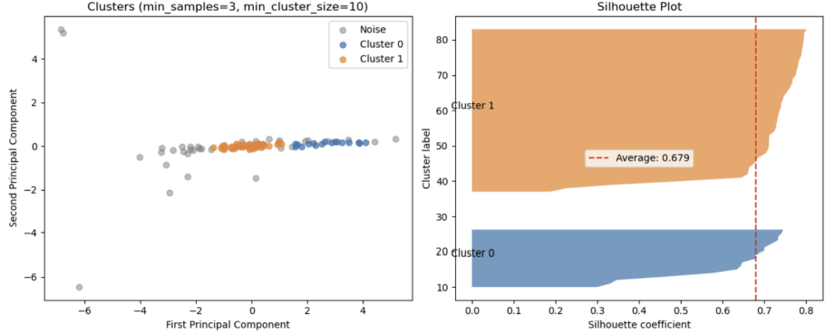
Clustering HDBScan
Features for Clustering (all log-transformed):
Mean daily count
Mean weekend count
Mean weekday count
Standard deviation of counts
Results:
Best model: Log-transformed with Min samples = 3 and min cluster size = 10
Evaluation Metrics:
Silhouette Score: 0.627
Results in 2 clusters
Model clusters 70 points (leaving 31 noise points)
Notes:
Chelsea
As an alternative to the kmeans model, we tried several variations of HDBSCAN models. I’ll present here our best fitting HDBSCAN model. First, we did a log-transformation on the hourly counts, since our data has such a heavy right skew. This makes the distances between high values less extreme so that the clustering algorithms can find more natural groupings. This model used these four features and starting parameters of 3 for minimum samples and 10 for minimum cluster size. This resulted in a model with two clusters, made up of 70 of the counters (so 31 were excluded as noise). The Silhouette Score was 0.62, a big improvement from the kmeans model.

Slide 20
Summary - Clustering Analysis
K-Means Clustering:
Best Model: 4 clusters with 3 features.
Evaluation Metrics:
Euclidean Average: 2.77
Manhattan Average: 4.79
Silhouette Score: 0.493
HDBSCAN:
Best model: Log-transformed with Min samples = 3 and min cluster size = 10
Evaluation Metrics:
Silhouette Score: 0.627
Results in 2 clusters
Model clusters 70 points (leaving 31 noise points)
Notes:
Dirk
A comparison of the two models shows that both have their weaknesses. The KMeans model captures all counters, but does not achieve the same Silhouette score as the other model (which means that the separation of the clusters is better in the HDBScan). The HDBScan achieves a good accuracy of fit of the data, but does not capture all counters. Around a third of the counters are treated as exceptions and are ignored. This is a major loss of information. There is room for improvement in the model here.

Slide 21
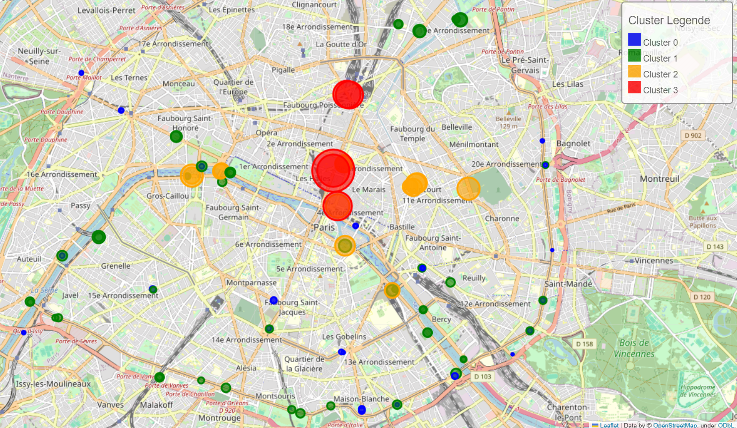
Clustering Results - Cycling Routes
K-Means (4 Clusters):
Cluster 0: Low traffic (blue).
Cluster 1: Moderate traffic (green).
Cluster 2: High traffic (yellow).
Cluster 3: Highest traffic (red).
Results:
Main route north-south corridor
Route along the Seine
Loop around Pairs
Notes:
Dirk
We used the results of the KMean-clustering for further analysis. The map provides a good overview of the distribution of the individual clusters in Paris. You can clearly see that the installation of main routes in Paris has led to corresponding usage. Our expectation that certain counters would have similar usage patterns was fulfilled. The fewest counts of cyclists are in the intermediate zones.

Slide 22
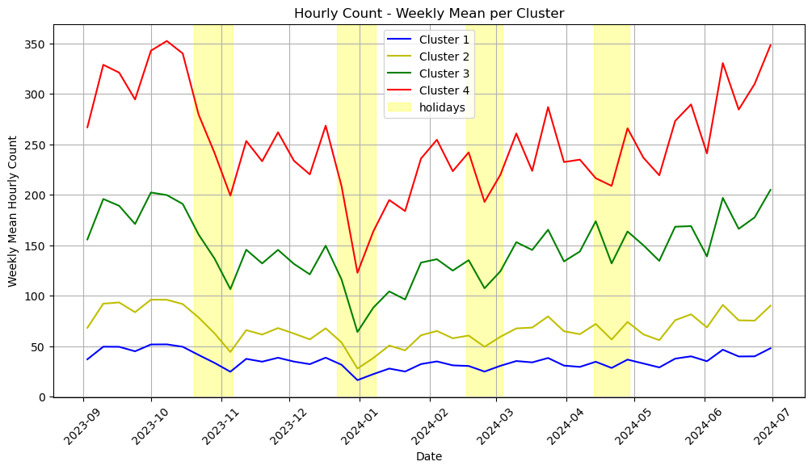
Clustering Results
Results:
Same pattern for all clusters
Reduced counts on public holidays
Conclusion:
Parisians are the main
cyclists, not tourists
Notes:
Dirk
This graph shows that the pattern of distribution of cycle use is similar for all four clusters. This suggests that it is mainly Parisians who use the cycle lanes.This assumption is reinforced by the fact that the number of cyclists decreased during the holidays.

Slide 23
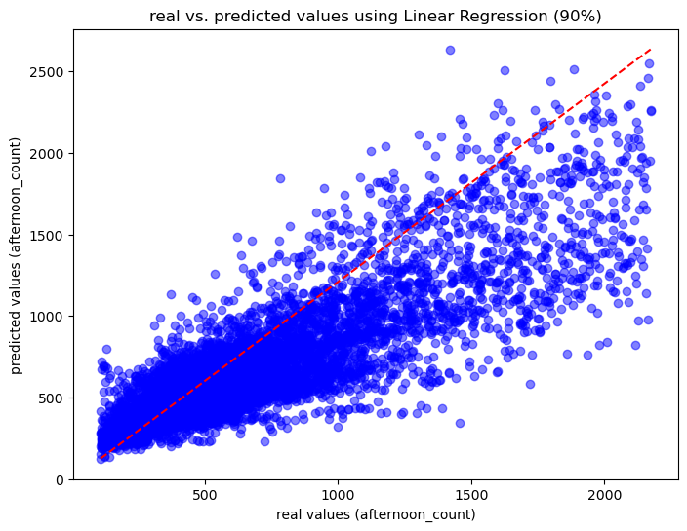
Regression Analysis
Features for Linear Regression:
Morning cyclist counts (6 AM to 12 PM).
Day of the week (weekday vs. weekend).
Holidays (binary flag).
PCA component (pc1) representing key
traffic patterns.)
Model Performance:
R² Score: 0.703
MSE: 59,786.60, MAE: 178.19, RMSE: 244.51
Results:
Moderately strong correlation between morning and afternoon counts (correlation coefficient: 0.75)
Weekends and holidays negatively impact cyclist counts
Notes:
Dirk
Finally, we developed a linear regression model to make a prediction for the expected traffic. The morning traffic counts are intended to predict the afternoon counts. For this, we used various features in different combinations, including a PCA component that we derived from the KMean-Clustering. The model delivers good results, but these could be improved. Again, there is the issue of many values being zero or close to zero, which negatively impacts the model. There is still some further research needed in this area.
—
Using the PCA method, a single component was formed from the three variables that were used as features for the clustering. This component and other features (morning counts from 6.00 to 12.00, day of the week and holidays) are used to predict bicycle use in the afternoon.

Slide 24
Overall Conclusion
Limitations:
Data gaps and missing data points may introduce bias.
Zero counts affect model accuracy.
Future Work:
Integrate additional data sources (e.g., population growth of the city).
Test further models (e.g., non-linear models) for better predictions.
Extend the analysis to include longer timeframes.
Eliminate the zero counts (over night, road closures, ect.)
Notes:
Dirk
Overall, we can say that our expectation was confirmed: residents of Paris, in particular, are using the cycling routes. One big challenge in our analysis was dealing with the many counts close to zero, which happen during nighttime hours or when there are road closures. If we had more time for the project, it would make sense to test additional regression models to improve the predictions. It would also help to include more data sources and look at a longer time period.

Slide 25
Questions ?
Notes:
Dirk
Do you have any questions? If not, we will go on with the Power BI Dashboard

Slide 26
Project Presentation
Paris’ Vision for Cycling:
Become one of the most bike-friendly cities in Europe.
Significant investments to enhance cycling infrastructure.
Data Source and Description:
opendata.paris.fr
Main DataFrame: Contains Hourly count of cyclists registered by the different bicycle counters across Paris.
Second DataFrame: Provides Detailed information about street addresses in Paris.

Slide 27
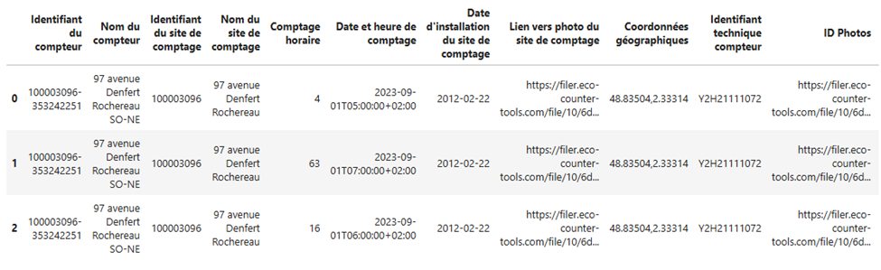
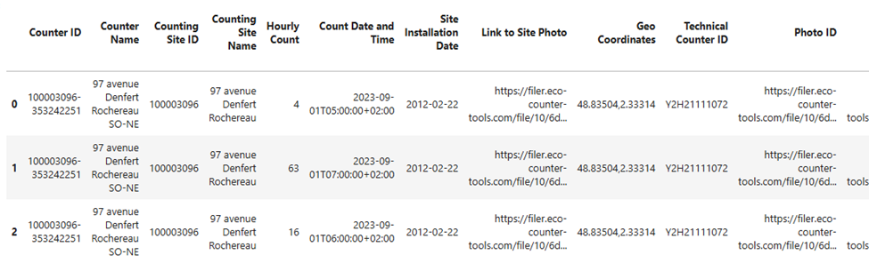
Data Exploration
Main DataFrame Overview:
Columns are originally in French and were translated into English
Notes:
here ‘s an overview of the df
dataset's columns were originally in French and were translated into English

Slide 28
Data Exploration
Main DataFrame Overview:
945853 rows and 16 columns
Readings from 2022 to 2024
Findings:
The ‘Count Date and Time’ and ‘Month and Year of Count’ columns need to be converted to datetime format.
No duplicates
Irrelevant missing values

Slide 29
Data Exploration
Descriptive statistics of our numeric variable:
‘Hourly count’
Findings:
High variability
Potential Outliers
Quartile Gap
Notes:
To explore more our df we checked the central tendencies and variability of our data.
We found out that :
High Variability: The data shows high variability, with a low mean (~79) and a high standard deviation (~109).
Potential Outliers: The wide range between the minimum (0) and maximum (8190) suggests the presence of significant outliers.
Quartile Gap: A large gap between the first quartile (Q1 = 12%) and third quartile (Q3 = 98%) further highlights the data's spread and variability.

Slide 30
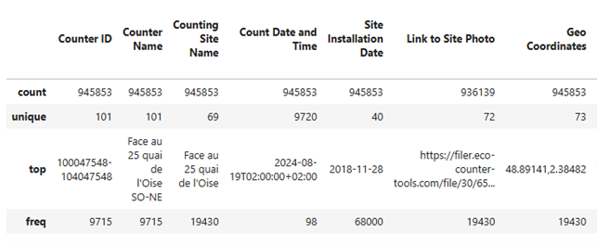
Data Exploration
Descriptive statistics of our non-numeric variable:
‘Counter Name’
‘Counting/Counter Site Name’
Findings:
101 unique counters across Paris
69 unique locations; some sites with separate counters capturing traffic in opposite directions
Notes:
To explore more our df we checked the central tendencies and variability of our data.
We found out that :
High Variability: The data shows high variability, with a low mean (~79) and a high standard deviation (~109).
Potential Outliers: The wide range between the minimum (0) and maximum (8190) suggests the presence of significant outliers.
Quartile Gap: A large gap between the first quartile (Q1 = 12%) and third quartile (Q3 = 98%) further highlights the data's spread and variability.

Slide 31
Data Exploration
Data preparation steps for data visualization:
Drop irrelevant columns
Reset the column index
Convert data format
Extract new features
Notes:
- From the column ‘Data and Time’ we extracted the date, time, day of the week, month and year and created new columns. Similarly, from the column ‘Geo Coordinates’ we created separate columns for longitude and latitude.
Our data consists of one main numeric variable (Hourly Count) and two main categorical values (Count Date and Time, Geo Coordinates), along with their subcategories.

Slide 32
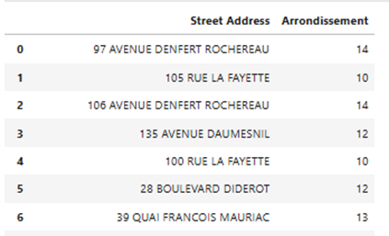
Data Exploration
Second DataFrame Overview:
151879 rows and 5 columns
Purpose:
Create an arrondissement table, mapping counter-street addresses to their corresponding arrondissement.
Merge type:
Left join
Notes:
- Merge Type:
Left join on extracted (street name) from the main (’counting site name’) dataset with the corresponding "Street name" in the second dataset.Column name
Column name: Description - Type - Column renamed
C_AR: Arrondissement number - Integer - Arrondissement
L_ADR: Full address (street number followed by the street name) - String - Counting Site Name

Slide 33
Data Exploration
Data Cleaning and Preprocessing Steps:
Second DataFrame
Drop irrelevant columns
Rename the columns properly
Remove missing values
Standardize the address name (remove hyphens, extra spaces)
Extract street details (number, type, name)
Main DataFrame
Extract unique values of ‘Counting site Name’ Column
Standardize the address name (convert to uppercase, replace special characters, etc.)
Replace specific names ( "COURS LA REINE": "CRS LA REINE")
Extract street details (number, type, name)
Notes:
Second DF:
standardize and clean the data, we performed several text transformations, such as removing hyphens and spaces, converting all street names to uppercase, and extracting key components like street number, type, and name. Special street number suffixes were also handled to ensure uniformity."
Main DF:
#Convert the text to uppercase
unique_st['Counting Site Name'] = unique_st['Counting Site Name'].str.upper()
#Replace any sequence of whitespace
unique_st['Counting Site Name'] = unique_st['Counting Site Name'].str.replace(r'\s+', ' ', regex=True)
#Remove leading and trailing white spaces
unique_st['Counting Site Name'] = unique_st['Counting Site Name'].str.strip()
# Remove any occurrences of "FACE," "AU," and "TOTEM" from the street names
unique_st['Counting Site Name'] = unique_st['Counting Site Name'].str.replace(r'\b(FACE|AU|TOTEM)\b', '', regex=True).str.strip()
# Change letters in "Counting Site Name" column
unique_st['Counting Site Name'] = unique_st['Counting Site Name'].str.replace('É', 'E').str.replace('Ô', 'O').str.replace('Ç', 'C')
# Change specific Counting Site Names
unique_st['Counting Site Name'] = unique_st['Counting Site Name'].replace({
"40 QUAI D'ISSY": "40 QUAI D'ISSY LES MOULINEAUX",
"COURS LA REINE": "CRS LA REINE",
"38 RUE TURBIGO": "38 RUE DE TURBIGO"
})

Slide 34
Regression Analysis
Features:
Morning cyclist counts (6:00 AM to 12:00 PM).
Day of the week (Monday to Sunday).
Holidays (binary).
PCA component (pc1) combining key features from clustering.
Objective:
Prediction of the afternoon counts (12:00 to 18:00)
Notes:
D: Using the PCA method, a single component was formed from the three variables that were used as features for the clustering. This component and other features (morning counts from 6.00 to 12.00, day of the week and holidays) are used to predict bicycle use in the afternoon.

Slide 35
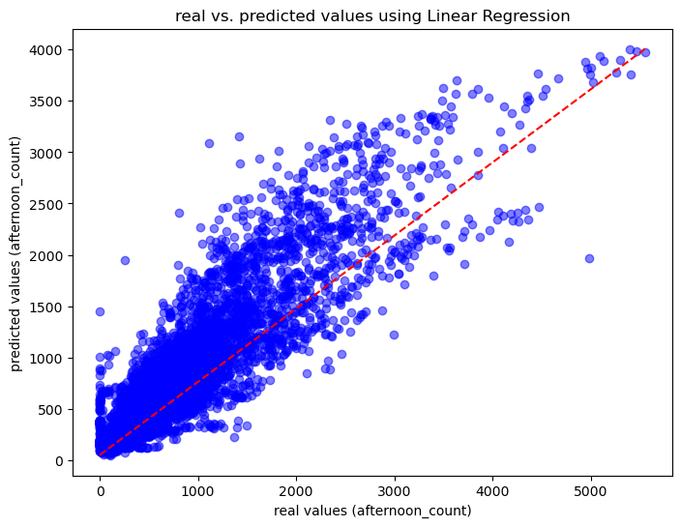
Regression Results
Model Performance:
Model Intercept: 403.457
Model Coefficient: 0.577
R² Score: 0.786
Mean Squared Error (MSE): 101,651.502
Mean Absolute Error (MAE): 214.943
Root Mean Squared Error (RMSE): 318.828
Results:
Strong correlation between morning and afternoon counts (correlation coefficient: 0.81).
Weekends and holidays negatively impact cyclist counts.
Notes:
D: The analysis shows satisfactory results, although the scatter and errors exhibit a relatively large variance. The graph clearly shows that there is a deviation between the predicted and actual values. This is possibly due to the high number of sums with zero.
( Model Intercept: the value of y when x=0
Model Coefficient: Slope of the regression line. It shows how much y changes on average when x increases by one unit.
R²: 0.786 means that 78.6 % of the variance of y is explained by x
MSE: average squared error between the predicted and actual values
MAE: measures the average absolute error between the actual and predicted values. predictions are off by an average of 214,943 units
RMSE: square root of the MSE and has the same unit as the dependent variable y. Compared to the MAE (214.943), the RMSE is higher, which indicates that there are some major errors (outliers) in the model. )

Slide 36
Comparison of Regression Models
Model 1 (All Counts):
R² Score: 0.786
MSE: 101,651.50
MAE: 214.943
RMSE: 318.828
Model 2 (90% Data after Removing Outliers):
R² Score: 0.703
MSE: 59,786.60
MAE: 178.19
RMSE: 244.51
Results:
Model 2 has lower errors, indicating better accuracy but explains less variance.
Notes:
D:
Model 1 showed room for improvement, especially in the handling of outliers. We therefore deleted the lowest and highest 5% of the counts. We assume that sums of zero or close to zero are exceptions, as are extremely high values. We have therefore removed these values from the dataset and run a new regression.
The result shows that the model has fewer errors, but at the same time explains less variance. At this point, there is room for further improvements to the model.

Slide 37
Conclusion Regression Models
Limitations:
PCA component difficult to interpret
Zero counts affect model accuracy
Future Work:
Less components for the regression
Test further models (e.g., non-linear models) for better predictions.
Increase the time period (week or month to make a prediction).
Notes:
D: The linear regression shows that there is a correlation, but it can only be explained moderately well with this model. Improvements concern the removal of the PCA variable and the use of the variables behind it as well as the use of other regression models that can handle the large number of smaller values better. One possibility is the decision tree. Another interesting option is to extend the time span of the analysis to a week or a month, for example.

Slide 38
Clustering Analysis
( Model Tested:
K-Means (4 clusters, 3 features)
K-Means (5 clusters, 3 features)
HDBSCAN (Density-Based Spatial Clustering)
Best Model: K-Means (4 clusters, 3 features)
Silhouette Score: 0.493
Clusters Identified:
Low traffic (residential areas).
Medium traffic (secondary roads).
High traffic (main corridors).
Highest traffic (city center & major routes). )

